Slide 1
Building agents
By: your favorite guy ever

Slide 2

Purpose of presentation
Project: ”internet of agents”
Internet decentralizes data: anyone uploads, system stores/queries, anyone downloads
This project decentralizes agents: anyone uploads an agent, the system routes/coordinates, anyone taps the coordinated system
By next Wednesday y’all should submit agents for us to ingest 😋
This presentation should make it as easy as possible for you to make system-compatible agents! (you’re welcome!)

Slide 3

What happens to your agent?
Becomes callable by everyone’s tasks
You maintain zero infrastructure (in most cases; not for hosting and providing an endpoint, not relevant here)
Code is kept as is, modifications made on our end: you should require minimal knowledge of our backend

Slide 4

What even is an agent?
AI research nowadays: wiring together things into a system, calling that system a thing, recurse
Internal prompt + probability dist of next token + repeated selection → basic language response
Wiring together different basic language responses → chain of thought → smarter language response
Language response + tool calls → language that can affect things → agent
Wiring together agents + more tools → big agents, agentic systems, etc.
Takeaway: ”agent” is a fuzzy term, so we’ll pin down exactly what OUR system needs

Slide 5

Agents in our system
Any service that completes certain tasks or processes input/output (I/O), etc.
Discovery and communication via A2A (more details next slide)
Common template: LLM tool loop
LLM sees system prompt + tool descriptions + extra context (i.e. from past loop iterations)
Loop: chooses from set of tools, runs the tool, repeats
We include a template of this to make agent-building easier

Slide 6
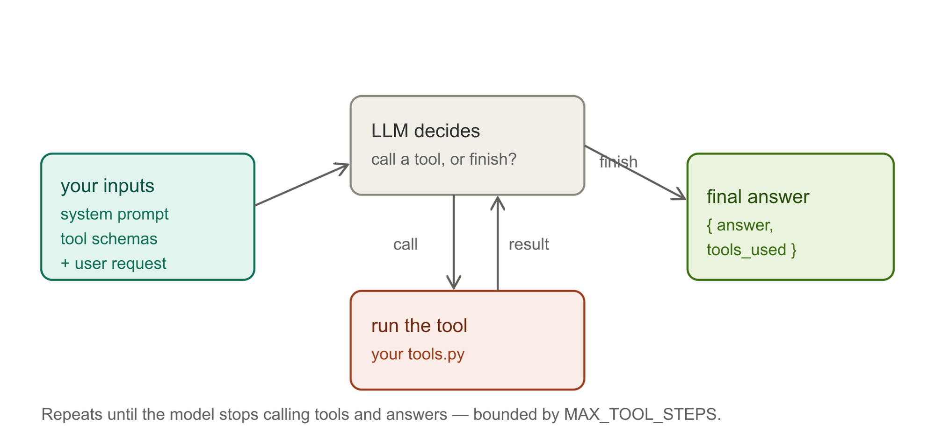
LLM tool loop visually

Slide 7
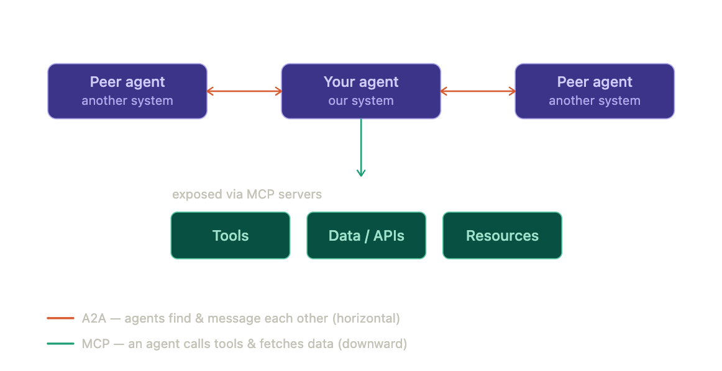
Protocols: A2A and MCP
MCP: down, from agent to tools
Open standard that gives an agent a uniform way to call external tools and pull in data
A2A: horizontal, from agent to agent
Open standard for independent agents to discover each other and exchange messages
What our system uses
Very recent convention, still changing

Slide 8
Two options for what to build
Option A: fill in LLM-tool loop
The task you want to automate can be decomposed into a system prompt + a few tools
Less control, simpler
E.g: pdf-reading agent that can call an OCR tool, then NLP call on the text with an LLM; decides which tools to use at each step and based on results of prior steps
Option B: custom folder upload
You already have a lot of convoluted code in a folder completing a task
More control, but also much more complex as you need to handle all the agent’s internals
E.g: agent composed of sub-agents each with their own LLM tool-loops

Slide 9
What only A requires
System prompt: what the agent is, when to use which tool, and instructions to end with a clear answer
Tool bodies: methods defined in a tool file
One high-level defined function per tool
Optional inputs need a default
Tool schemas (JSON)
NLP descriptions of each tool, parameters, etc.
Can have claude generate from your tools very easily
Examples in agent-skeleton
Function argument names must match schema’s field names exactly
Number of iterations of top-level loop

Slide 10
What only B requires
Folder of code and/or data that takes input and completes task
Two hard rules:
Must run standalone
Must have one clear entry point (one class in one file that runs whole agent)
Entry point (“handler”) details:
Tiny handler.py file with one class and one method that the system calls
In: user’s text + any attached files + API keys if needed (note: files are tricky without agent-skeleton package base.FileInput)
Inside: pass those inputs to the code’s entry point class and run the method
Out: dict with an “answer”: response + data artifacts
At minimum: make sure full agent’s functionality can be exposed by calling parameters with a single python file

Slide 11
What both require
README.md
Natural language description of what the agent does
Explicit I/O description of the agent
Identification of entry point file and class name
Hardware dependencies listed clearly in HARDWARE_DEPENDENCIES.md
Handling of secrets (private API keys and such)
I.e. you might not want to trust us with your secrets yet !
Private API keys called as variable names with config file left out of what you send us
For security and also so different users can slot in their own personal keys

Slide 12
Other considerations
If you need an API key for LLM calls:
We are seeing if we can provide something
In the meantime, try to find something free online
Alternatively, tunnel into RIS and run on a compute node
Generally prefer stateless (OpenAI ChatCompletions standard) of LLM calls
Repo to help y’all out: agent-skeleton

Slide 13

Repository we provide: agent-skeleton
Repo meant to help you make agents
If you choose A (LLM tool loop):
Provide infrastructure so you only need to write custom prompt, tool bodies, and tool schemas
If you choose B (custom upload):
Imports to help write entry point/handler
Lots of documentation to help you out with either option

Slide 14
Actual code examples
PDF agent (go through code on VS code)

Slide 15
Thinking about what agent you might want to make
Agents should help with research tasks
Can help with common operations or esoteric tasks
E.g. common: PDF reader, making graphs given data, etc.
E.g. esoteric: spinning up analysis of a gene given specialized dataset and bot that can understand/traverse dataset
Some example (very simple) agents we have:
Google calendar/email editor
Weather forecast agent
Coding agent

Slide 16
How to know you’re done and then what to do
Run your agent until it returns the expected output
Put your agent in a github repository and share it with us for review

Slide 17
Conclusion
The agent-skeleton repository has a lot of information and will continue to be updated
Documentation, templates, infrastructure
Answering FAQs
Example agents, more details about esoteric endeavors, etc.
We will send out this presentation

